Slide 1
LQR with bug fixed;

Slide 2
Issue – the coefficient matrix was wrong
In the code I use to flexibly make models with diff regressors, wasn’t careful about the ordering of the regressors
Always saved and analyzed the predictions and readout of the predictions (KG*predictions). The predictions were always in the correct order because they predicted the spikes matrix that was extracted straight from the datafile (whereas the regressors matrix was a DataFrame with 1D columns, where each column was a regressor (spikes had to be split into 1D variables – e.g. spk_tm1_n0, spk_tm1_n1, …)
So, when I saved coefficients matrices, they mapped from spikes to correct order of spikes;
Issue was that when I was analyzing the coefficient matrix and using the coefficient matrix in the LQR, LQR was controlling neurons that were mapped incorrectly through;
Correcting the issue gives more reasonable eigenvalues for the A matrix;

Slide 3
Corrected grom days with intercept and ridge regression

Slide 4
Corrected grom days withOUT intercept
and ridge regression

Slide 5
LQR, R = 0.001 WITH INTERCEPT vs. shuffle;
CO
OBS
Mean U
Total U
Shuffle or Zero
Real data
(frac change
from shuff/zero)
Still some obstacle hitting issues;

Slide 6
LQR, R = 0.001 WITH INTERCEPT vs. zeroA with intercept;
Still some obstacle hitting issues;

Slide 7
LQR, R = 0.001 WITH INTERCEPT vs. zeroA with zerointercept;
Still some obstacle hitting issues;

Slide 8
LQR, R = 0.001 withOUT INTERCEPT vs. shuffle;

Slide 9
LQR, R = 0.001 withOUT intercept vs. zeroA;

Slide 10
LQR, R = 0.001, Latent LDS (ndim =20) vs. shuffle (gray) and zero (black); Line plot is vs. zero

Slide 11
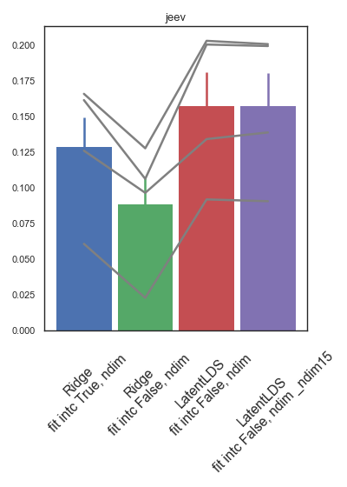
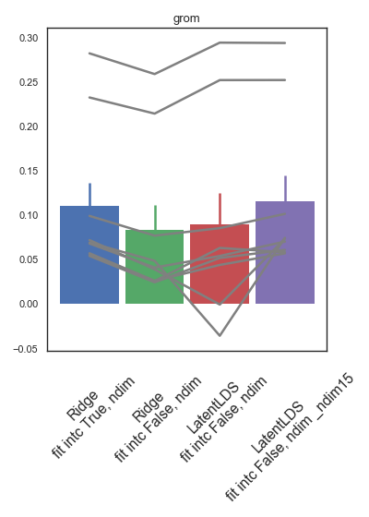
Next steps – assess R2 of diff models
“Full” dim = as high as possible w/ non-singular Q matrix (after removing cells with mFR < 0.5Hz)

Slide 12
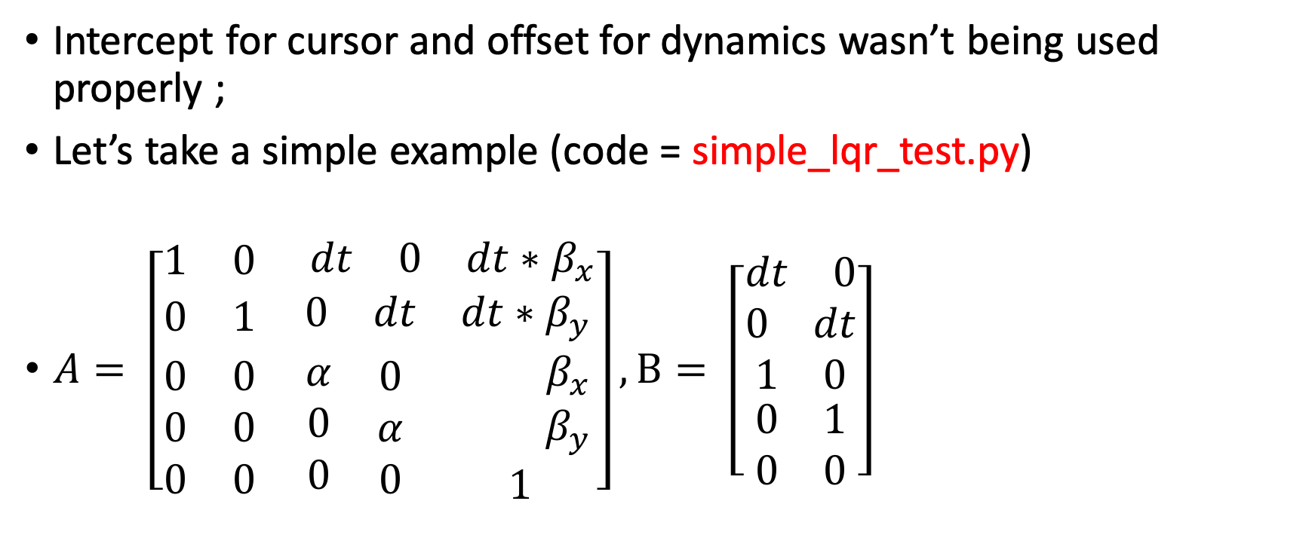
Ok was an issue in the above LQR results;
Intercept for cursor and offset for dynamics wasn’t being used properly ;
Let’s take a simple example (code = simple_lqr_test.py)
$A= \left[\begin{matrix}1 & 0 & \begin{matrix} dt & 0 & dt∗β_{x}\end{matrix} \\ 0 & 1 & \begin{matrix}0 & dt & dt∗β_{y}\end{matrix} \\ \begin{matrix}0 \\ 0 \\ 0\end{matrix} & \begin{matrix}0 \\ 0 \\ 0\end{matrix} & \begin{matrix}\begin{matrix}α \\ 0 \\ 0\end{matrix} & \begin{matrix}0 \\ α \\ 0\end{matrix} & \begin{matrix}{ β}_{x} \\ { β}_{y} \\ 1\end{matrix}\end{matrix}\end{matrix}\right], B= \left[\begin{matrix}\begin{matrix}\begin{matrix}dt & 0\end{matrix} \\ \begin{matrix}0 & dt\end{matrix} \\ \begin{matrix}1 & 0\end{matrix}\end{matrix} \\ \begin{matrix}0 & 1\end{matrix} \\ \begin{matrix}0 & 0\end{matrix}\end{matrix}\right]$

Slide 13
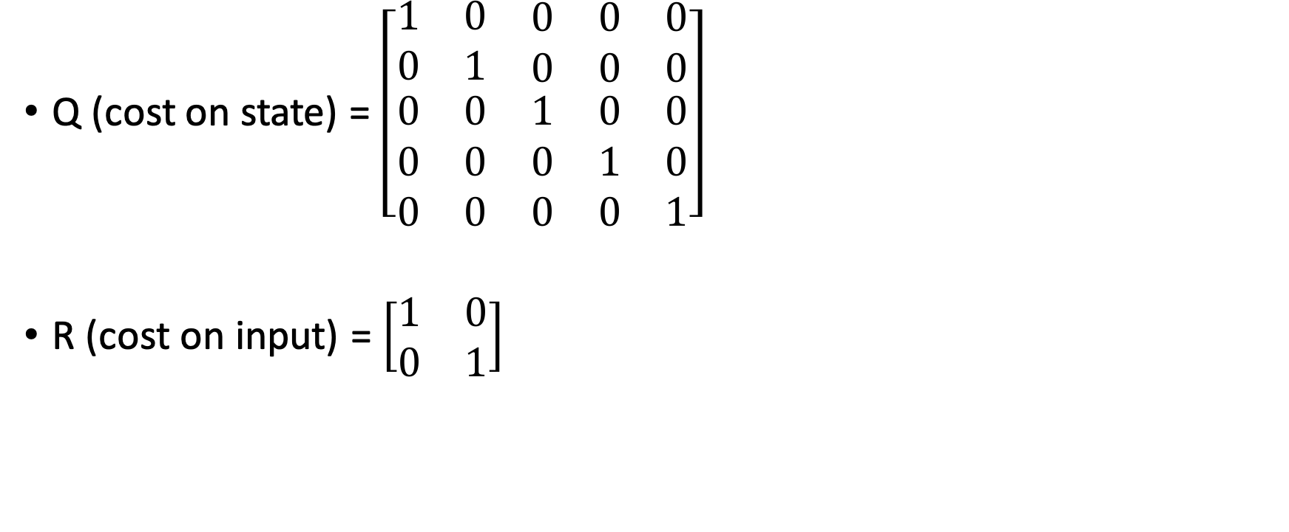
LQR;
Q (cost on state) = $\left[\begin{matrix}1 & 0 & \begin{matrix}0 & 0 & 0\end{matrix} \\ 0 & 1 & \begin{matrix}0 & 0 & 0\end{matrix} \\ \begin{matrix}0 \\ 0 \\ 0\end{matrix} & \begin{matrix}0 \\ 0 \\ 0\end{matrix} & \begin{matrix}\begin{matrix}1 & 0 & 0\end{matrix} \\ \begin{matrix}0 & 1 & 0\end{matrix} \\ \begin{matrix}0 & 0 & 1\end{matrix}\end{matrix}\end{matrix}\right]$
R (cost on input) = $\left[\begin{matrix}1 & 0 \\ 0 & 1\end{matrix}\right]$

Slide 14
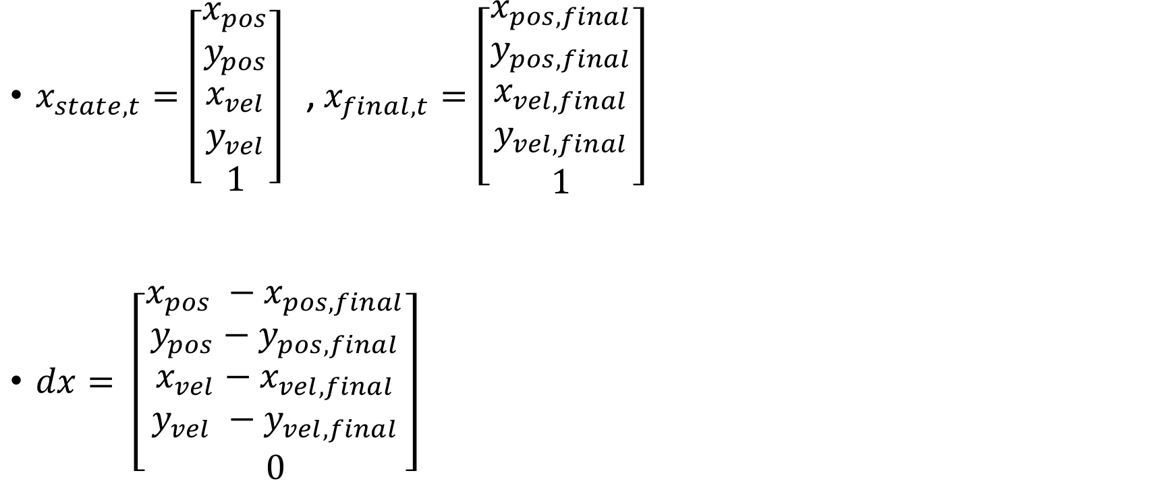
At each time point, compute error in state;
$x_{state,t}=\left[\begin{matrix}x_{pos} \\ y_{pos} \\ \begin{matrix}x_{vel} \\ y_{vel} \\ 1\end{matrix}\end{matrix}\right]$ , $x_{final,t}=\left[\begin{matrix}x_{pos, final} \\ y_{pos,final} \\ \begin{matrix}x_{vel,final} \\ y_{vel,final} \\ 1\end{matrix}\end{matrix}\right]$
$dx= \left[\begin{matrix}x_{pos} −x_{pos,final} \\ y_{pos}−y_{pos,final} \\ \begin{matrix}x_{vel}−x_{vel,final} \\ y_{vel} −y_{vel,final} \\ 0\end{matrix}\end{matrix}\right]$
This needs to be “1” otherwise doesn’t compensate for offset;

Slide 15
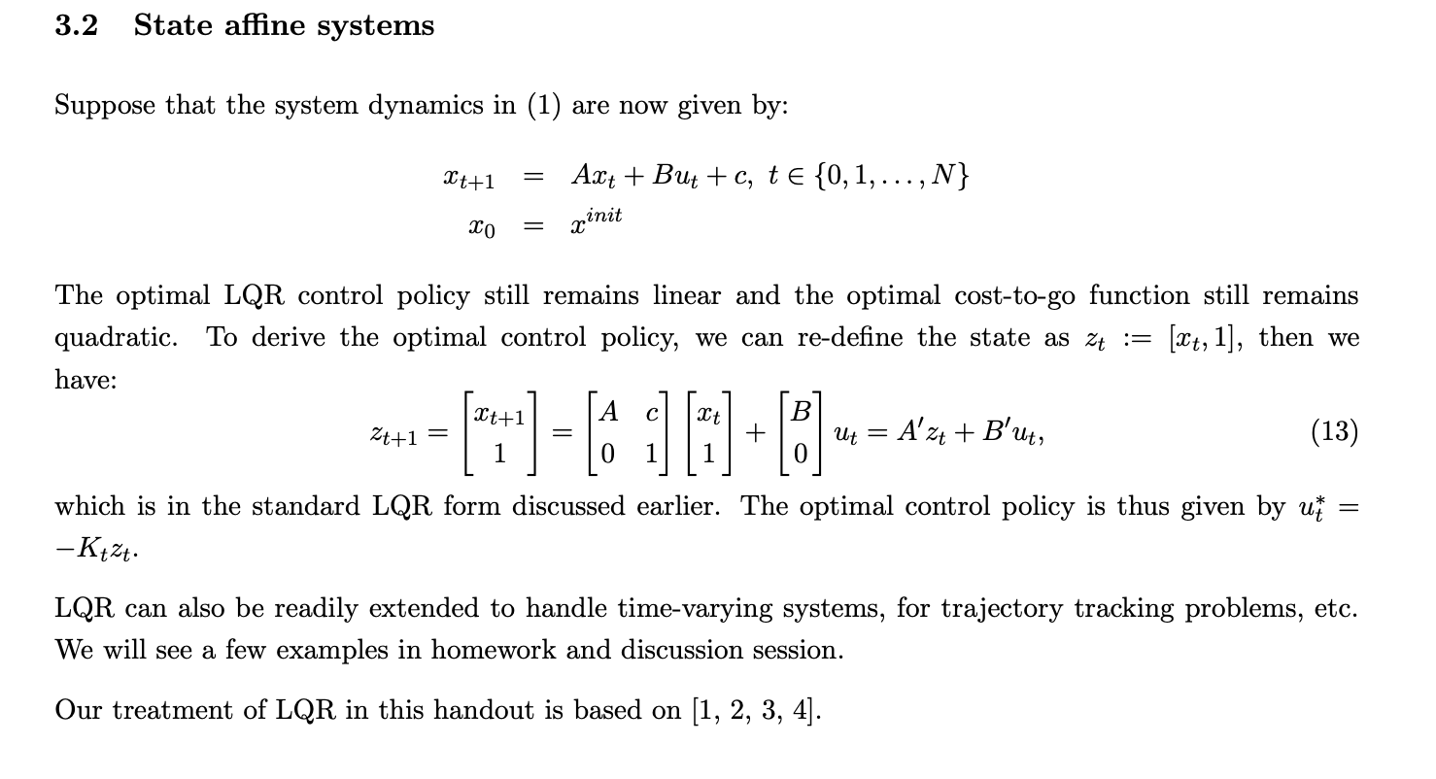
Source: https://inst.eecs.berkeley.edu/~ee221a/fa19/lectures/Lecture11b_Somil.pdf

Slide 16
R = 1., KG with cursor offset Ridge with intercept: Gray= Shuffle

Slide 17
R = 1., KG with cursor offset Ridge with intercept: Gray= ZeroA ,non-zero Intec from shuffle

Slide 18
R = 1., KG with cursor offset Ridge with intercept: Gray= ZeroA , Zero Intec

Slide 19
R = 1., KG with cursor offset Ridge withOUT intercept: Gray= Shuffle

Slide 20
R = 1., KG with cursor offset Ridge withOUT intercept: Gray= ZeroA

